Slide 1


A place for collaborative interview preparation

Slide 2
Contributors:
Sanjay Varma Datla - 002754014 (UI, SignUp, Login, JWT, Email verification)
Tiyasha Sen - 002727486 (UI, Job Listings, )
Ruthala Shiva charan - 002775946 (UI, Mock Interview, Google Drive & Google Calendar Intergration, Deployment)
Nikhil Reddy Polepally. - 002776998 (UI, Interview Experience, Calender)

Slide 3
Purpose:
Tech companies are known for their rigorous interview process.
PrepBuddy is a collaboration tool which makes your journey towards job search much easier in cracking the interviews.
PrepBuddy offers peer-to-peer mock interviews.
Applicants can post their interview experiences in the portal to simulate community-based learning.
Users can also share the job postings to reduce hassle.

Slide 4




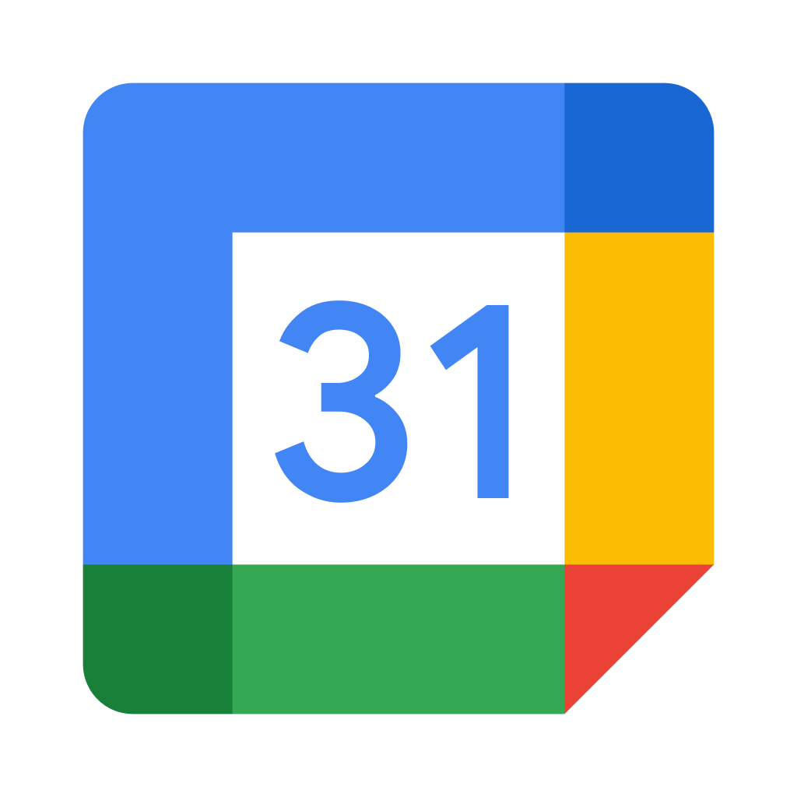






:
:

Slide 5
Features
Register and login Functionality
Email verification by sending an email with expirable link
Password hashing with Bcrypt
API authentication using JWT.
CRUD on job listings , interview experiences and mock interviews.
Search on Job listings.
Supports peer-to-peer mock interviews based on the availability.
Integrated google calendar with unique google meet link for each interview

Slide 6
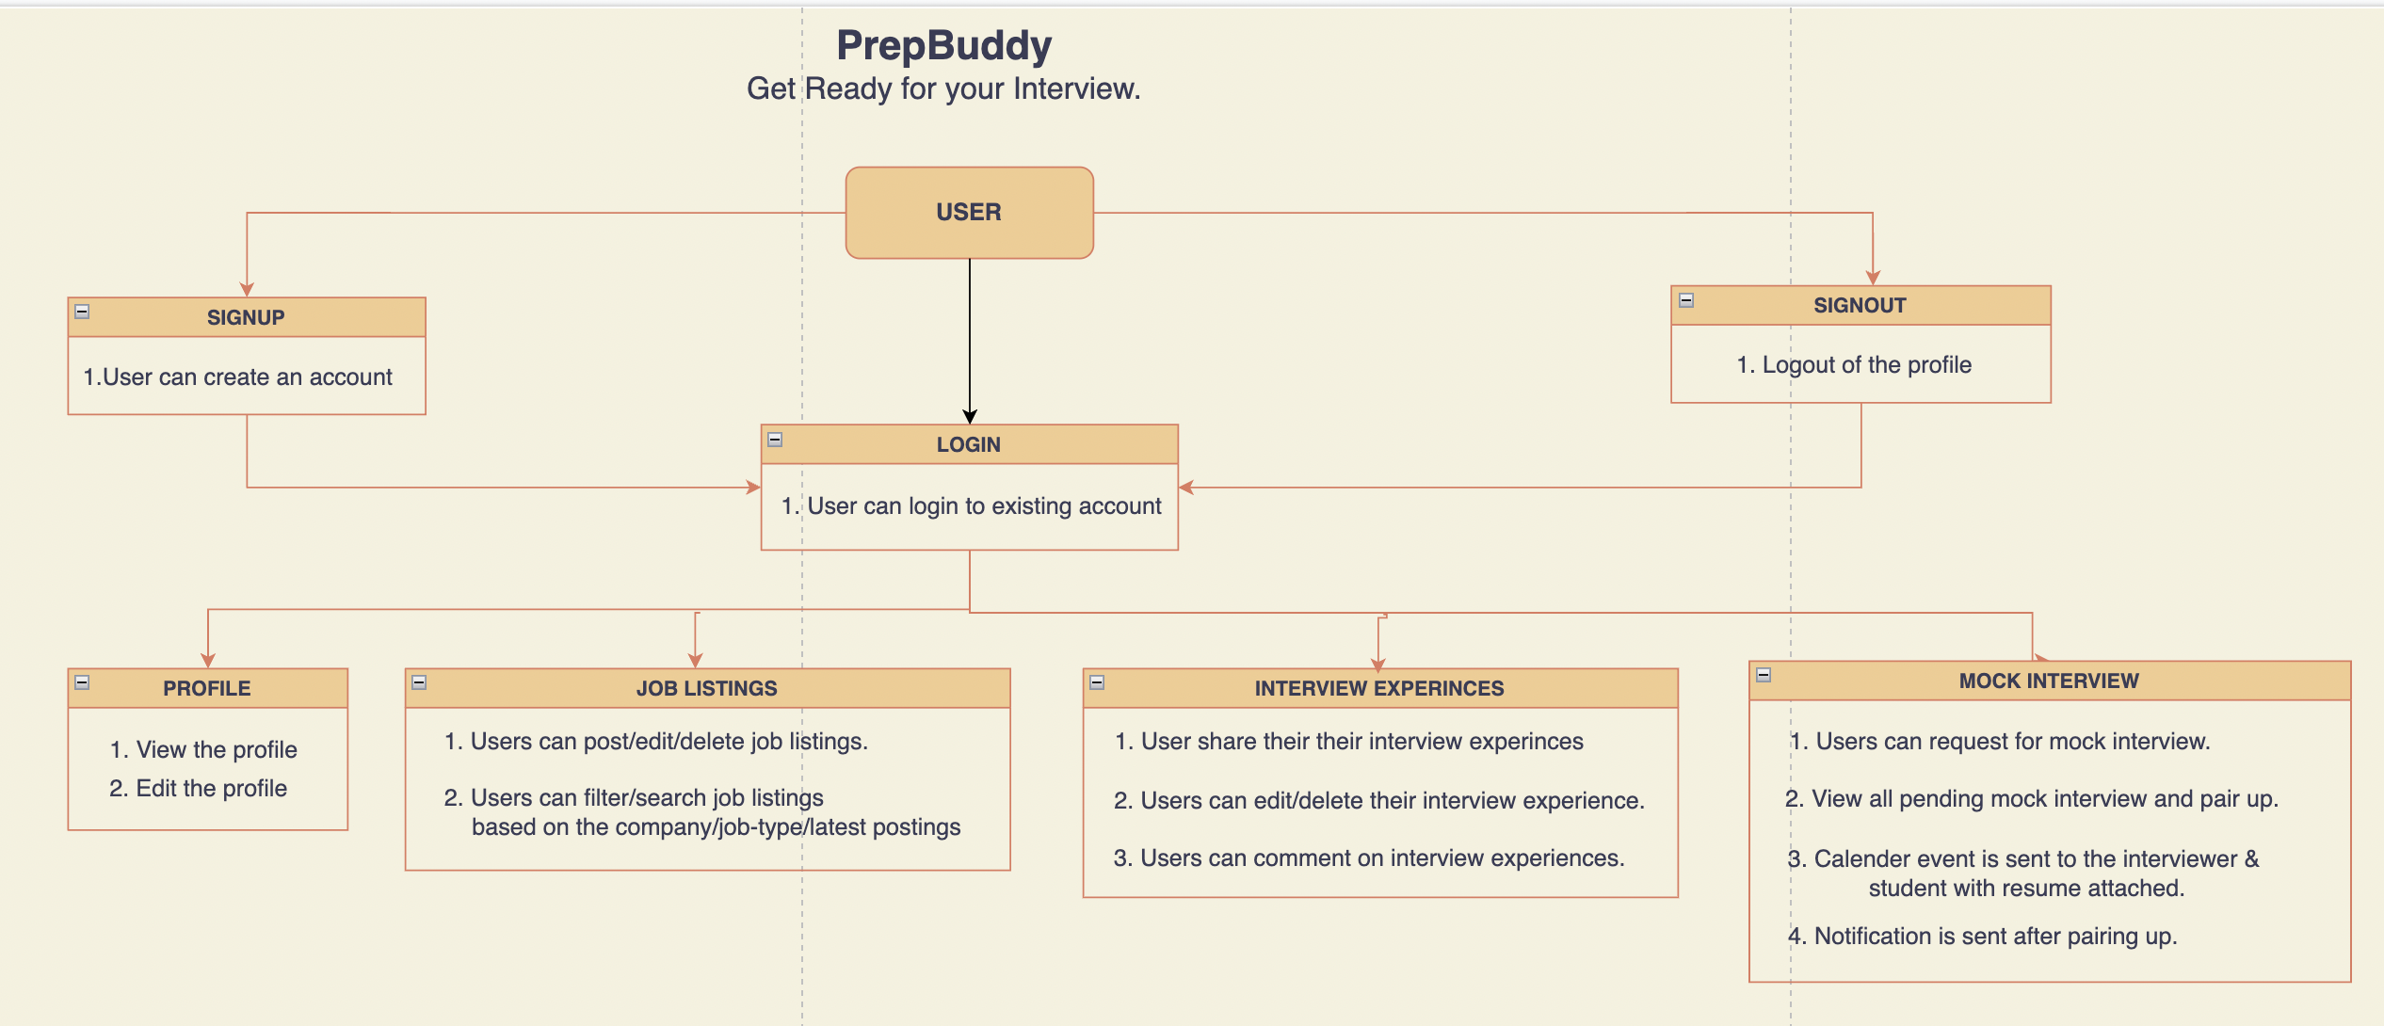

Slide 7
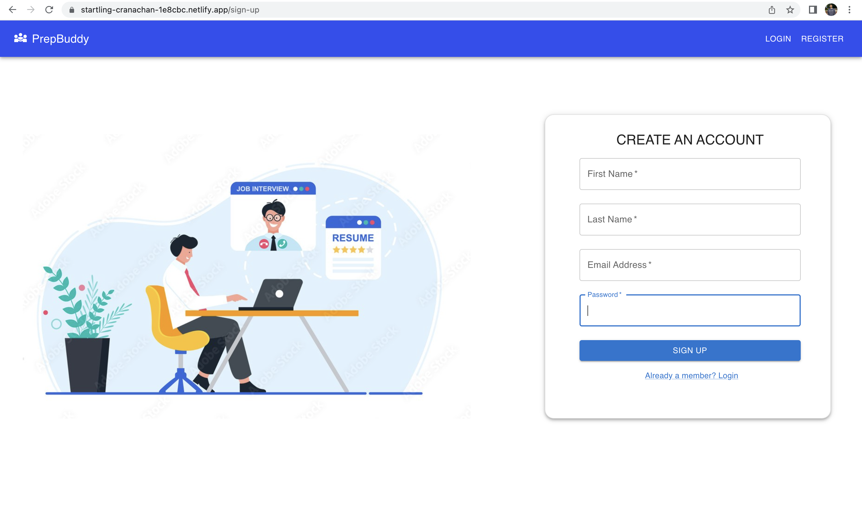

Slide 8
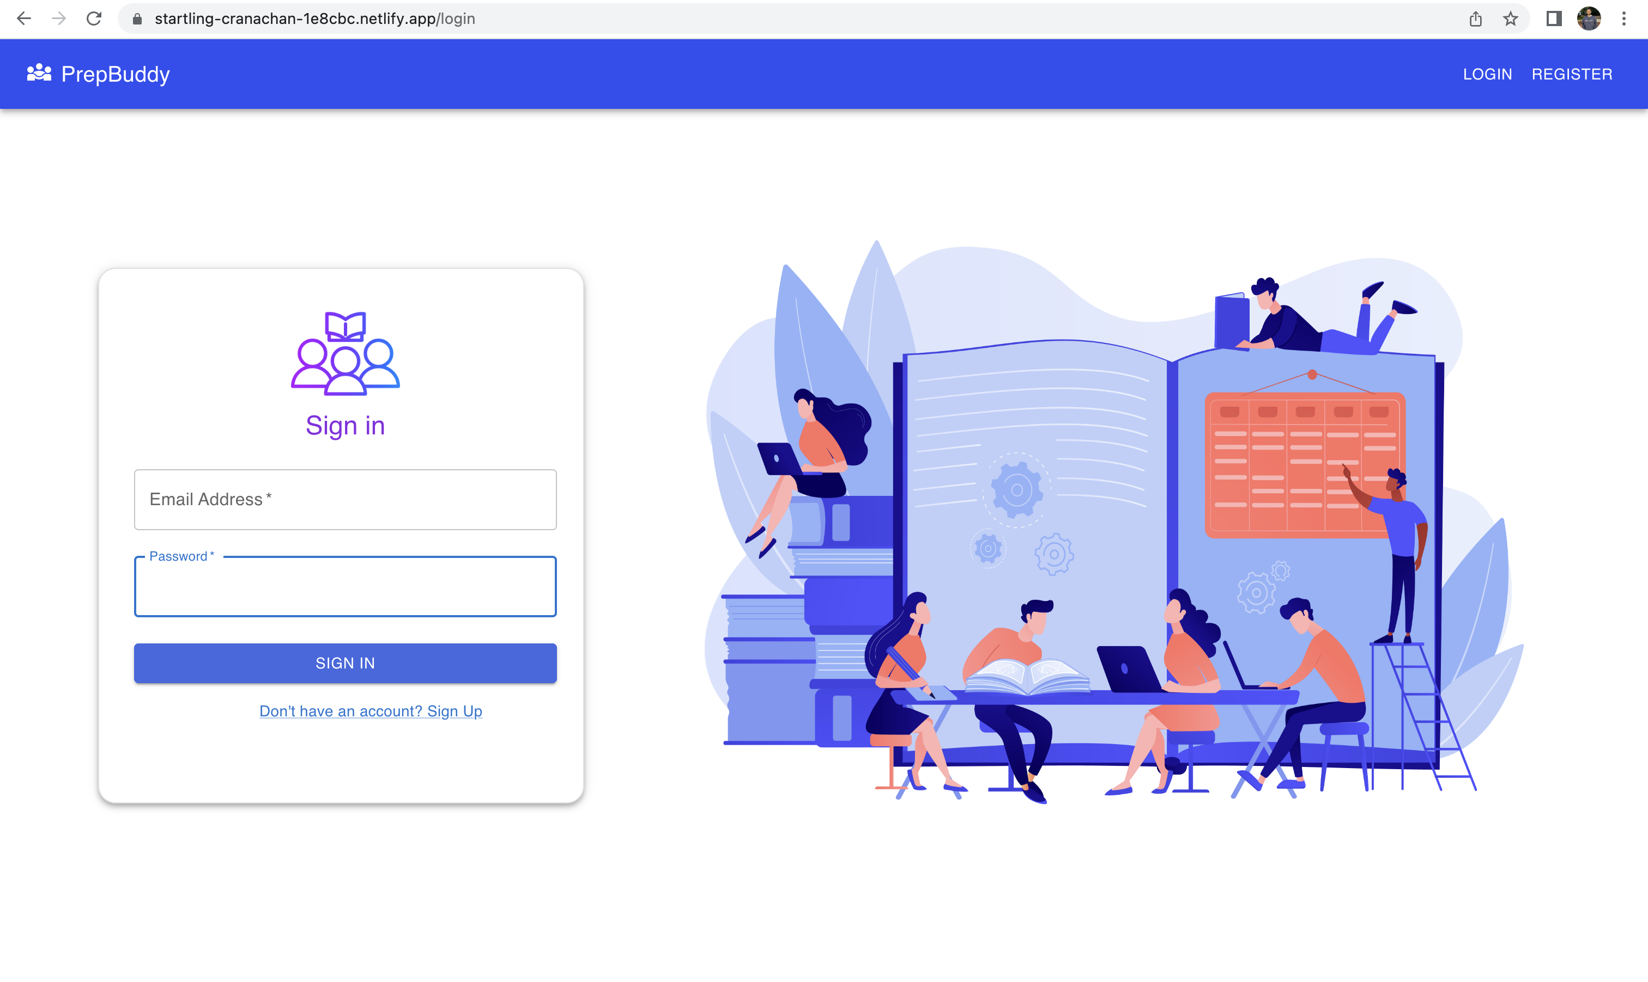

Slide 9
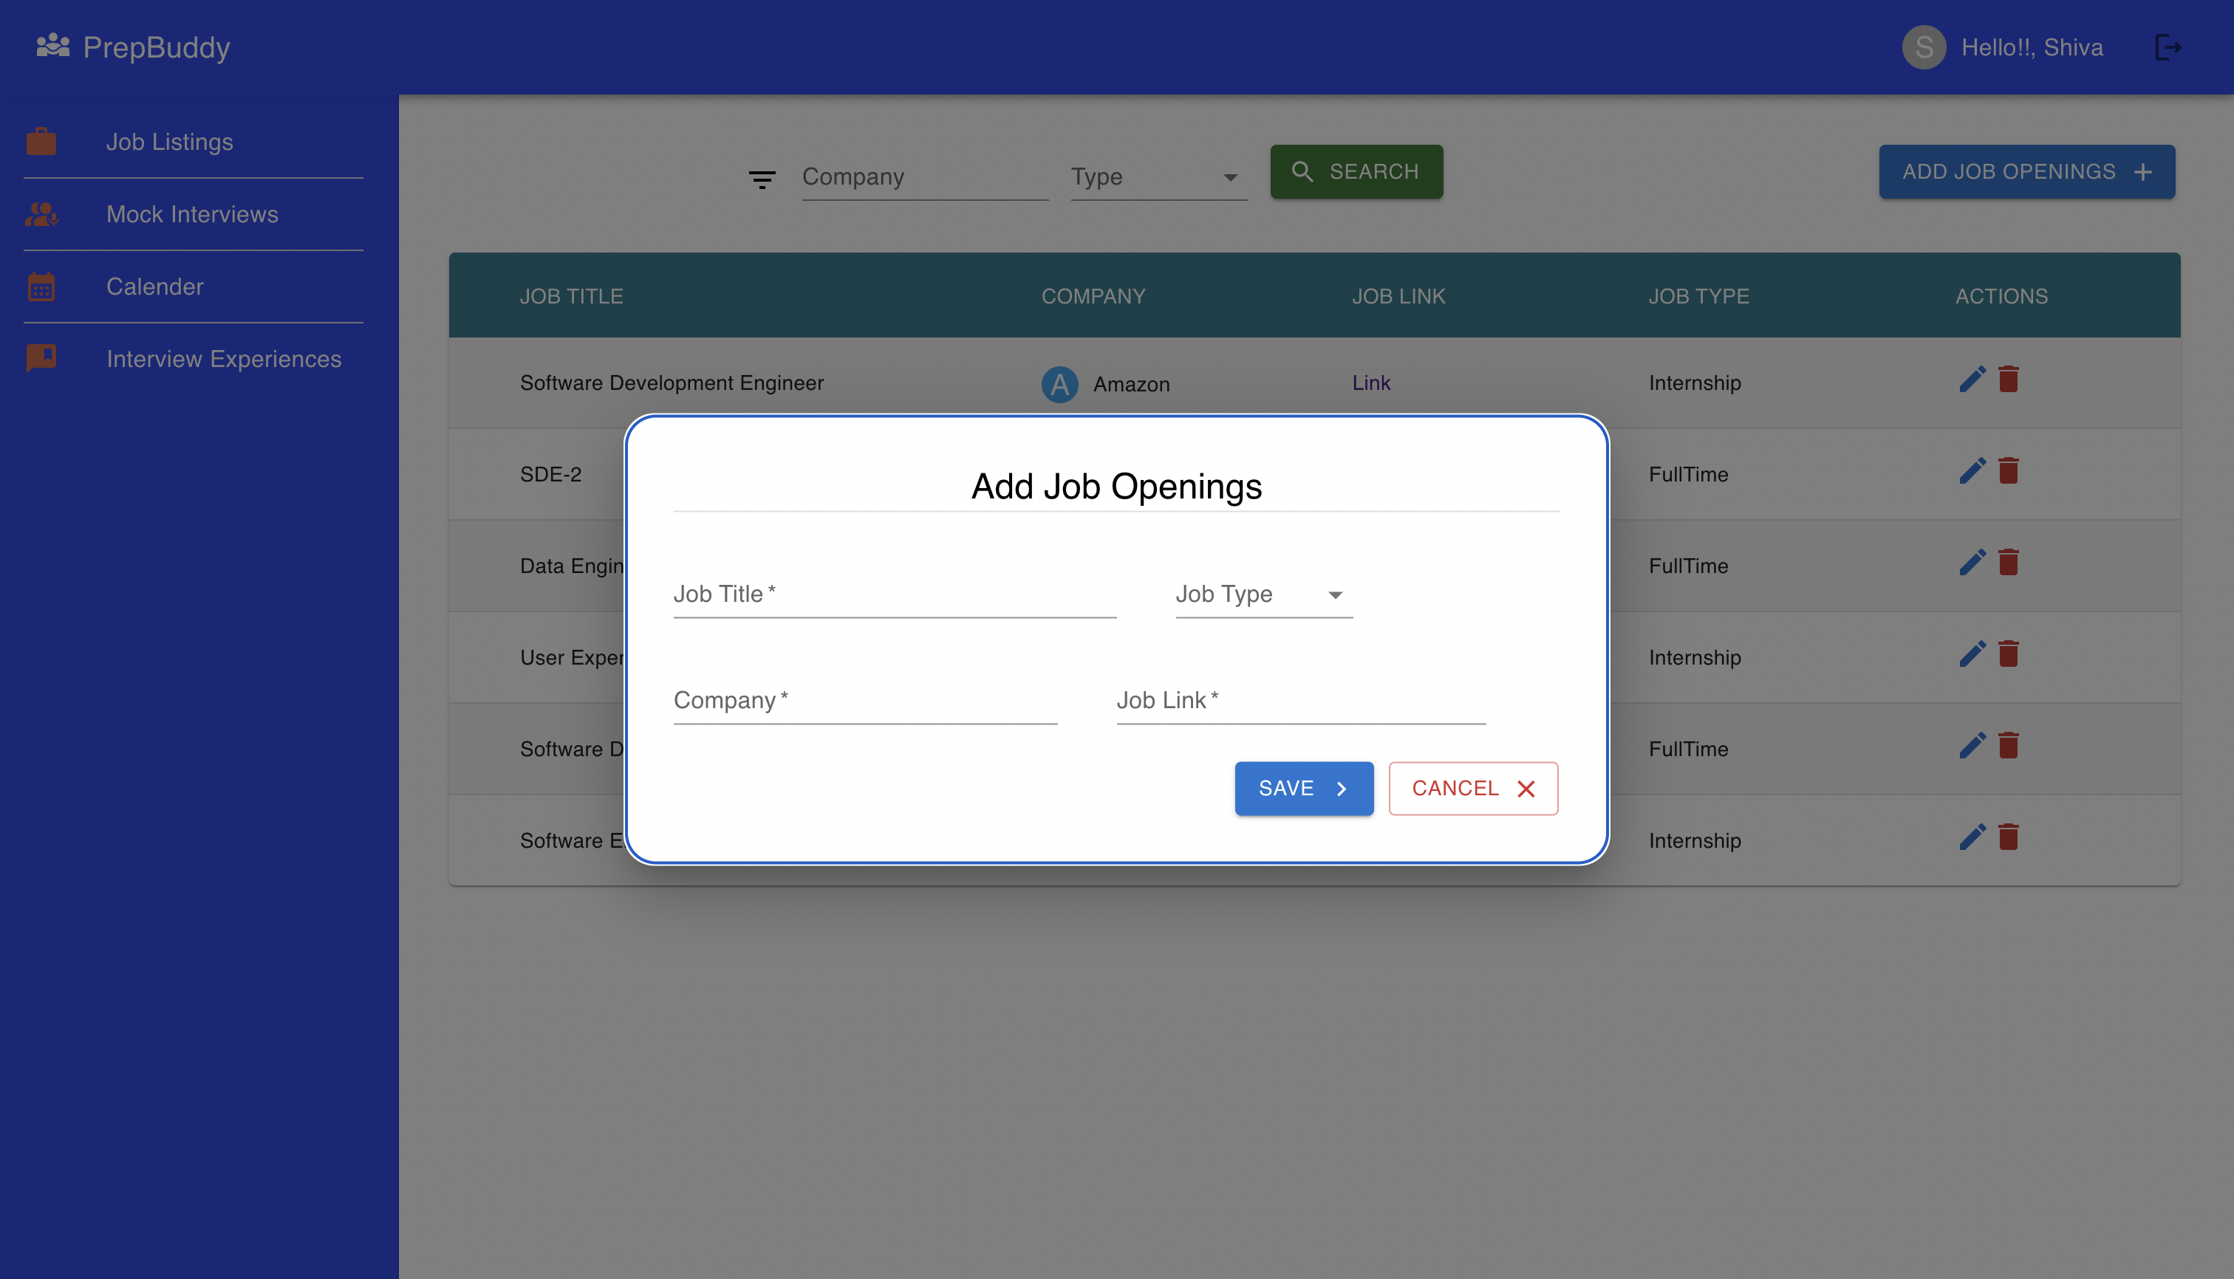

Slide 10
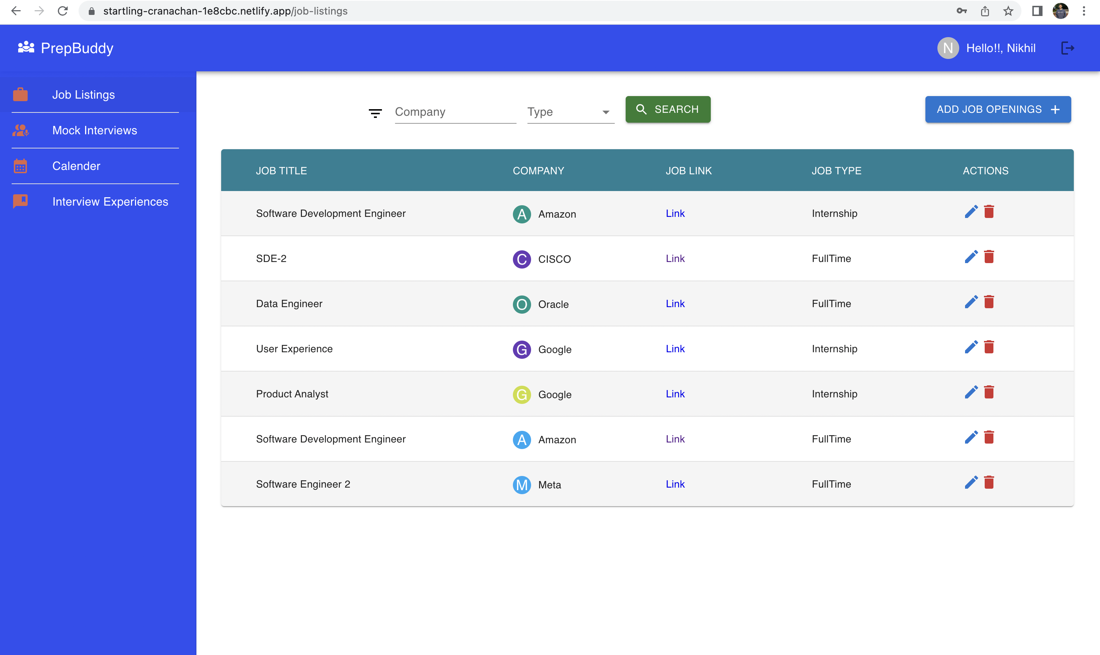

Slide 11
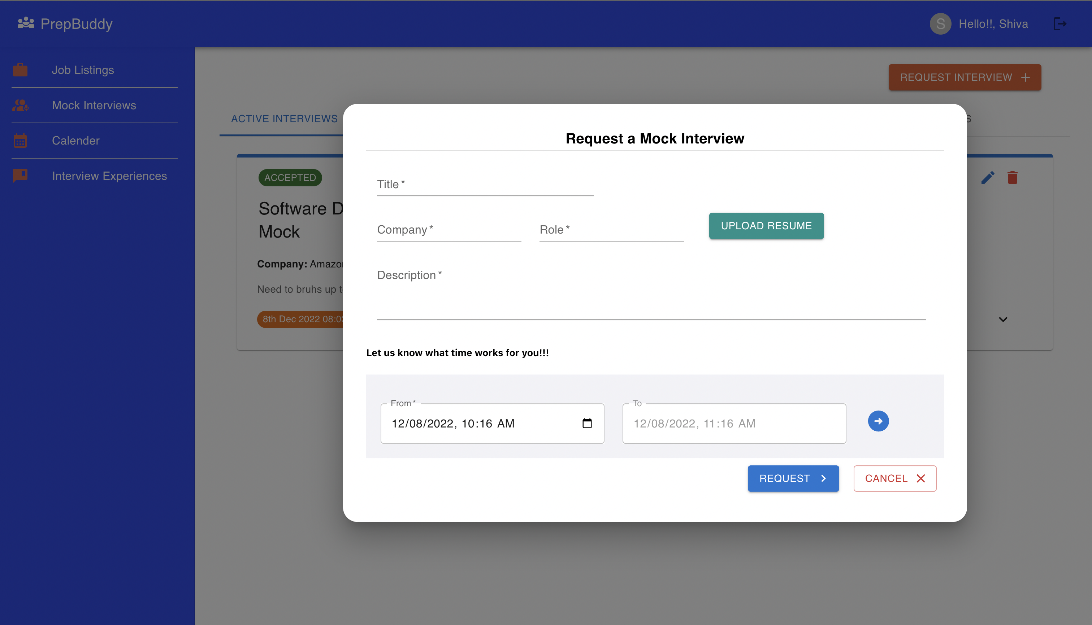

Slide 12
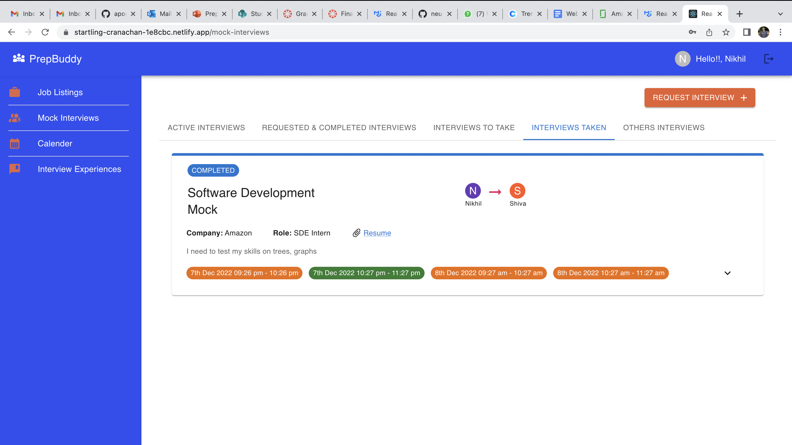

Slide 13
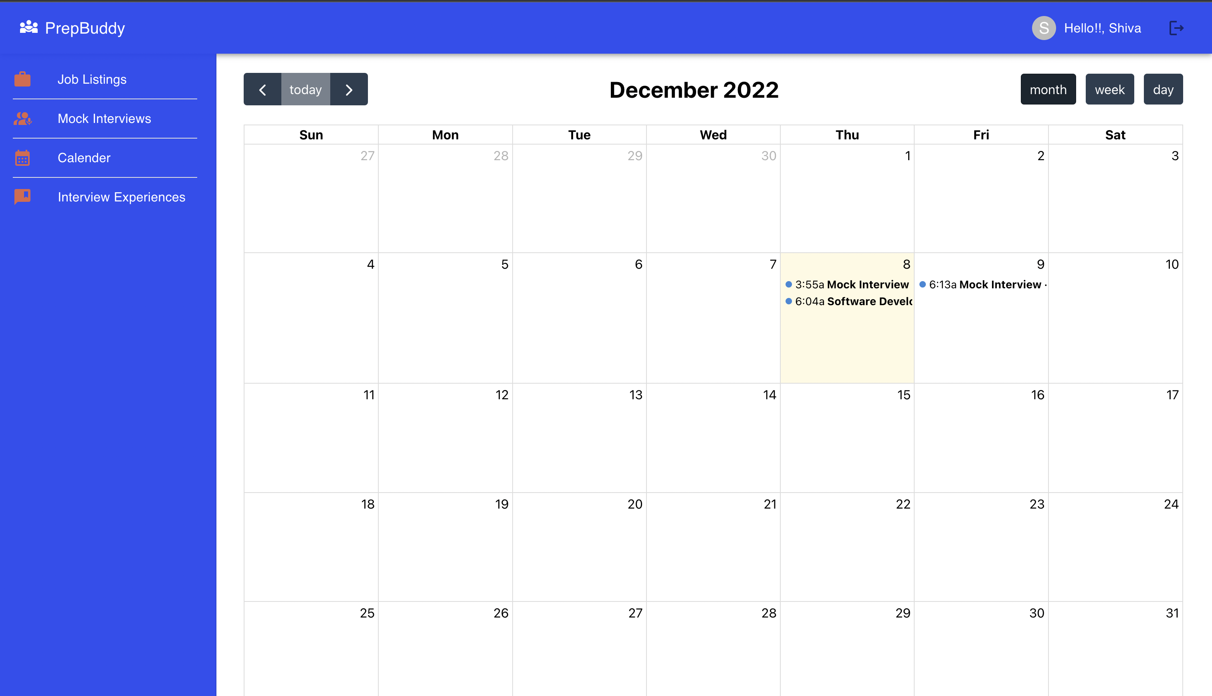

Slide 14
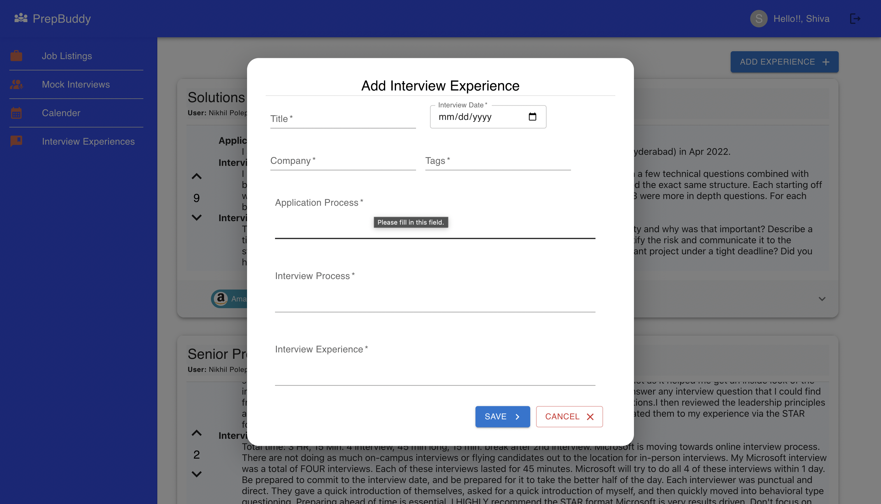

Slide 15
